Slide 1
Advanced SQL Project
Operation Analytics and Investigating Metric Spike
Created BY- Mainak Mukherjee
Email- subha.mainak@gmail.com

Slide 2
| Approach |
I thoroughly examined the dataset after importing the database into MySQL Workbench. I made an ER Diagram of the whole dataset by carefully examining each table, its columns, rows, and the connections between them. I need the information to comprehend the given database and have business knowledge before I can discover the answers to the questions. I constructed a data model that included the number of rows and columns in each table, the data type, the key, the linkages, and other details after doing data profiling. Following all of this, I began looking up the answers to the questions that were given to me.

Slide 3
| Tech-Stack Used |
To query the database, I utilised Oracle's MySQL Workbench version 8.0.31 for project execution. It was a useful tool for project execution because of its graphical user interface, troubleshooting support, and simplicity of access and setup.

Slide 4
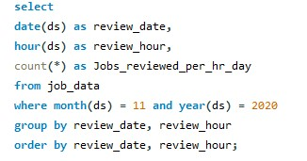
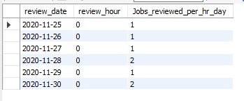
| Case Study 1: Job Data Analysis |
1. Jobs Reviewed Over Time: Calculate the number of jobs reviewed per hour for each day in November 2020.
Input
Output

Slide 5
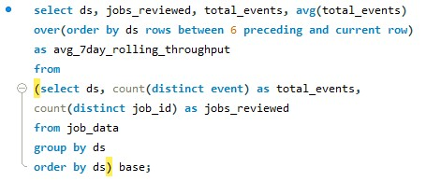
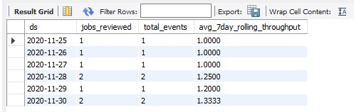
| Case Study 1: Job Data Analysis |
2. Throughput Analysis: Calculate the 7-day rolling average of throughput.
Input
Output

Slide 6
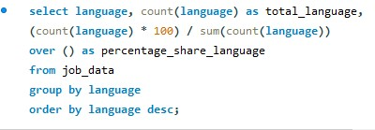
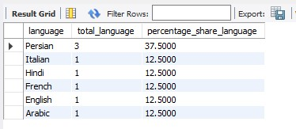
| Case Study 1: Job Data Analysis |
3. Language Share Analysis: Calculate the percentage share of each language over the last 30 days.
Input
Output
Insight:- For Persian language the share is 37.5% and for rest of the languages the share is 12.5% each.

Slide 7

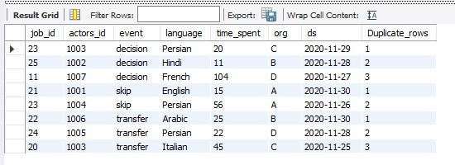
| Case Study 1: Job Data Analysis |
4. Duplicate Rows Detection: Display duplicate rows from the job_data table.
Input
Output
Insights:- Job-id 23(1st) has 1 duplicate row, Job-id 25 has 2 duplicate rows, Job-id 11 has 3 duplicate rows, Job-id 21 has 1 duplicate row, Job-id 23(2nd) has 2 duplicate rows, Job-id 22 has 1 duplicate row, Job-id 24 has 2 duplicate rows, Job-id 20 has 3 duplicate row.

Slide 8
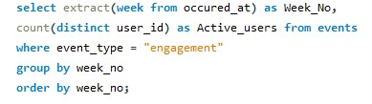
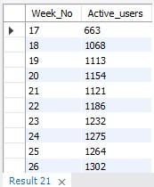
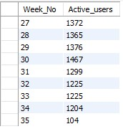
| Case Study 2: Investigating Metric Spike |
1. Weekly User Engagement: Calculate the weekly user engagement.
Input
Output

Slide 9
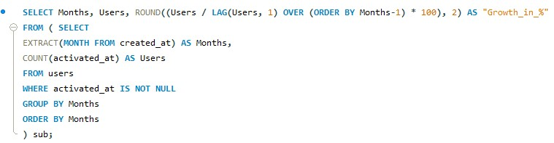
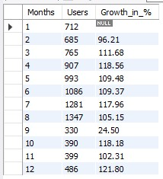
| Case Study 2: Investigating Metric Spike |
2. User Growth Analysis: Calculate the user growth for the product.
Input
Output

Slide 10
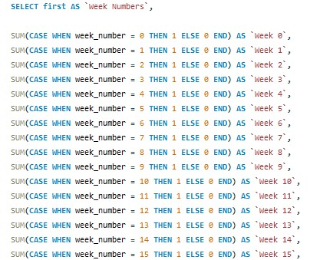
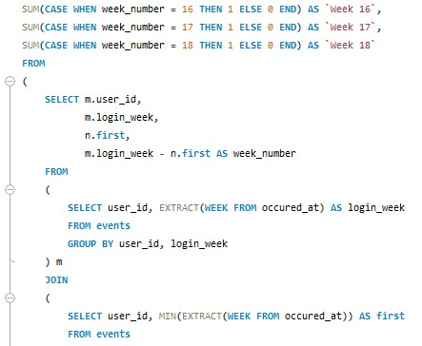
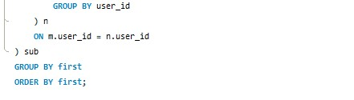
| Case Study 2: Investigating Metric Spike |
3. Weekly Retention Analysis: Calculate the weekly retention of users based on their sign-up cohort.
Input

Slide 11
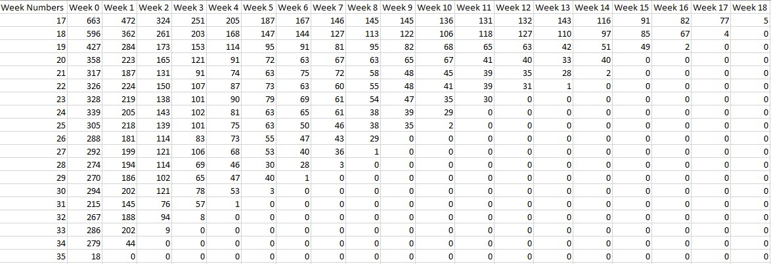
| Case Study 2: Investigating Metric Spike |
3. Weekly Retention Analysis: Calculate the weekly retention of users based on their sign-up cohort.
Output
* Due to Size and fitting issue the sql result table is exported in .csv format then the screen shot is taken.

Slide 12
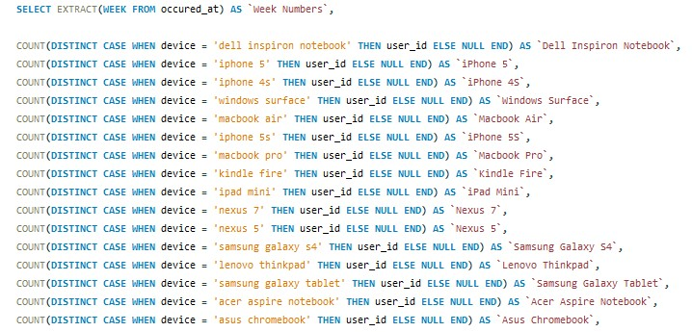
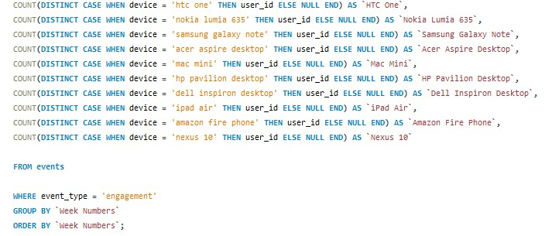
| Case Study 2: Investigating Metric Spike |
4. Weekly Engagement Per Device: Calculate the weekly engagement per device.
Input

Slide 13
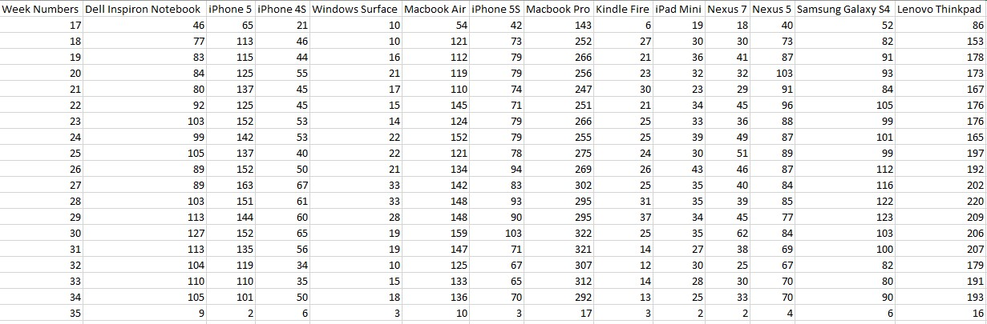
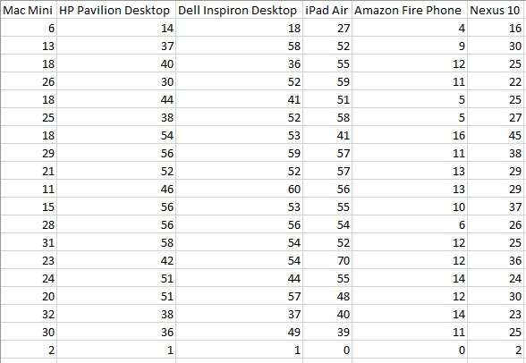
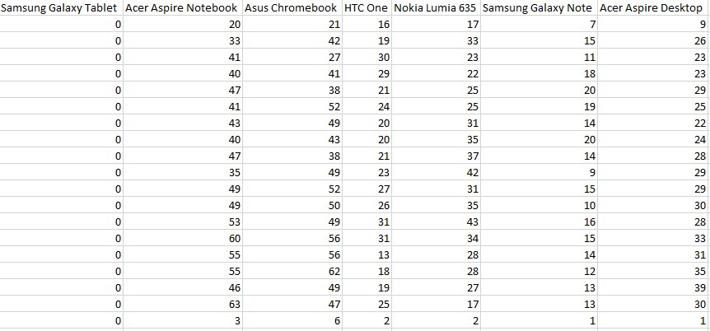
| Case Study 2: Investigating Metric Spike |
4. Weekly Engagement Per Device: Calculate the weekly engagement per device.
Output

Slide 14
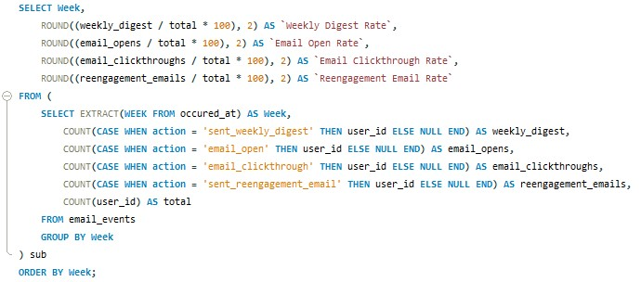
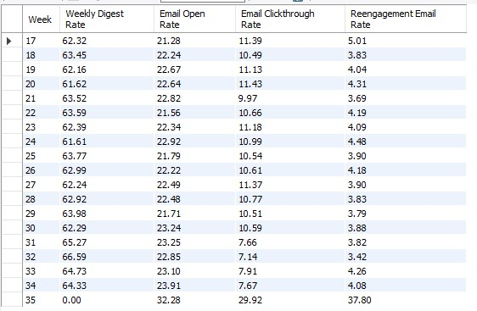
| Case Study 2: Investigating Metric Spike |
5. Email Engagement Analysis: Calculate the email engagement metrics.
Input
Output

